Slide 1
Network+ Guide to Networks Eighth Edition
Chapter 4
Network Protocols and Routing
© 2019 Cengage. All Rights Reserved. May not be copied, scanned, or duplicated, in whole or in part, except for use as permitted in a license distributed with a certain product or service or otherwise on a password-protected website for classroom use.

Slide 2
Objectives
4.1 Describe the functions of core T C P/I P protocols
4.2 Identify how each protocol’s information is formatted in a T C P/I P message
4.3 Explain how routers manage internetwork communications
4.4 Employ various T C P/I P utilities for network discovery and troubleshooting

Slide 3
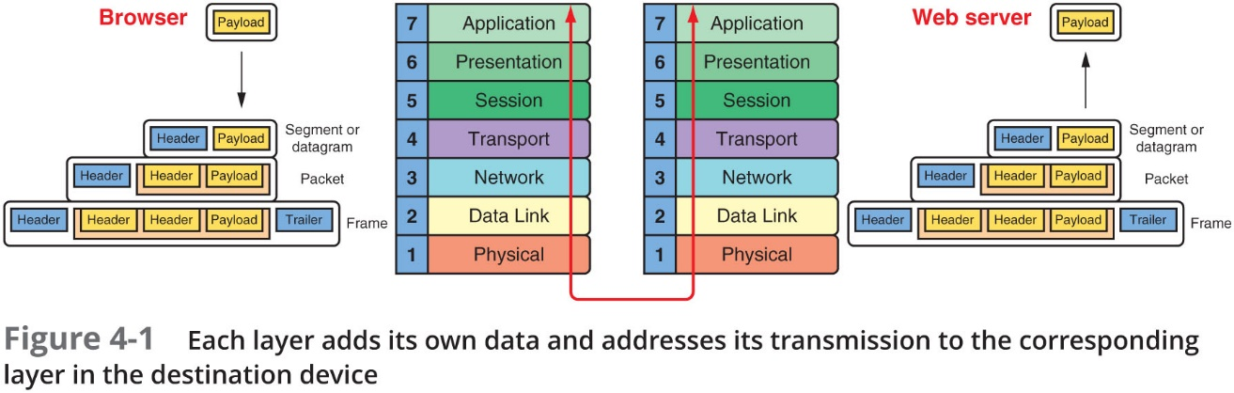
T C P/I P Core Protocols (1 of 3)
T C P/I P—A suite of protocols including:
T C P, I P, U D P, A R P, and many others
T C P/I P protocols add a header to data inherited from the layer above it

Slide 4
T C P/I P Core Protocols (2 of 3)
Layers 7, 6, and 5—Data and instructions, known as payload, are generated by applications running on source host
Layer 4—A Transport layer protocol, usually T C P or U D P, adds a header to the payload
Includes a port number to identify the receiving app
Layer 3—Network layer adds it own header and becomes a packet
Layer 2—Packet is passed to Data Link layer on N I C, which encapsulates data with its own header and trailer, creating a frame
Layer 1—Physical layer on the N I C receives the frame and places the transmission on the network

Slide 5
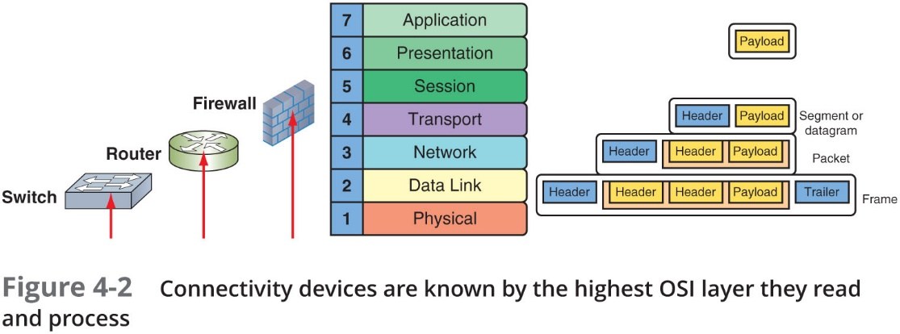
T C P/I P Core Protocols (3 of 3)
Receiving host de-encapsulates the message at each layer in reverse order and presents payload to the receiving applications
In transit, transmissions might pass through a number of connectivity devices
Connectivity devices are specialized devices that allow two or more networks or multiple parts of one network to connect and exchange data
Known by the highest O S I layer they read and process

Slide 6
T C P (Transmission Control Protocol) (1 of 4)
T C P operates in the Transport layer of O S I model
Three characteristics of T C P:
Connection-oriented—T C P ensures that a connection or session is established by using a three-step process called a three-way handshake
Sequencing and checksums—T C P sends a character string called a checksum that is checked by the destination host along with a sequence number for each segment
Flow control—Gauges rate of transmission based on how quickly recipient can accept data

Slide 7
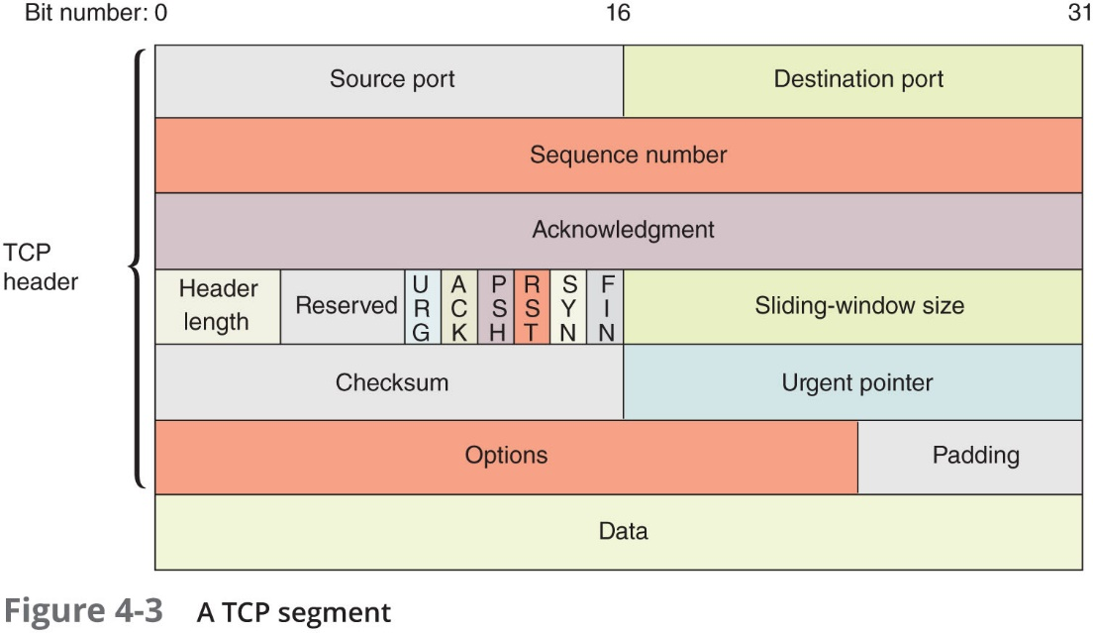
T C P (Transmission Control Protocol) (2 of 4)
Fields in a T C P Segment

Slide 8
T C P (Transmission Control Protocol) (3 of 4)
T C P uses a three-way handshake to establish a connection
Three transmission sent before data transmission:
Step 1—Request for a connection (S Y N)
Step 2—Response to the request (S Y N/A C K)
Step 3—Connection established (A C K)
After the three initial messages, the payload or data is sent
Sequence numbers will be increased by the number of bits included in each received segment
Confirms the correct length of message was received

Slide 9
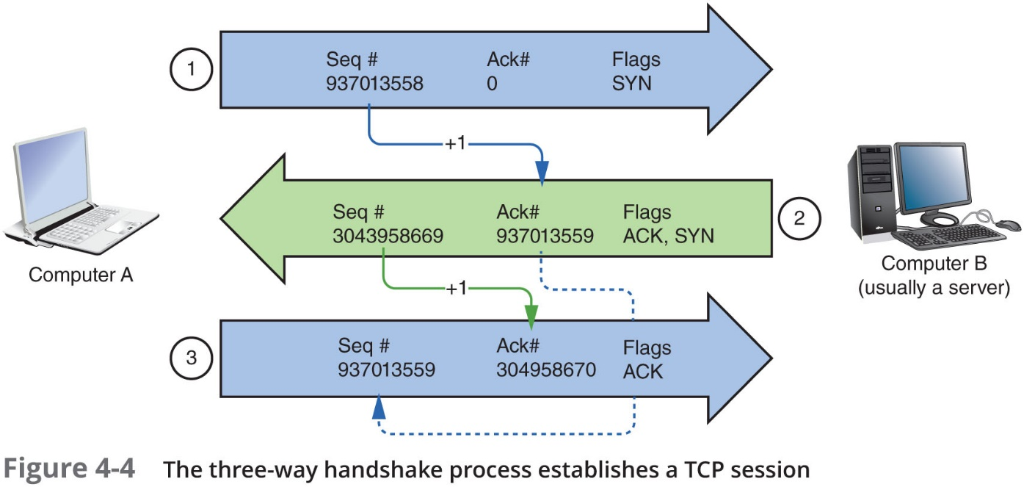
T C P (Transmission Control Protocol) (4 of 4)

Slide 10
U D P (User Datagram Protocol) (1 of 2)
U D P is an unreliable, connectionless protocol:
No three-way handshake is performed
Does not guarantee delivery of data
U D P provides no error checking, sequencing, or flow control
Makes U D P more efficient than T C P
Useful for live audio or video transmissions over the Internet
Also more efficient for carrying messages that fit within one data packet
A U D P header contains only four fields: Source port, Destination port, Length, and Checksum
Use of Checksum field in U D P is optional in I P v 4, but required in I P v 6

Slide 11
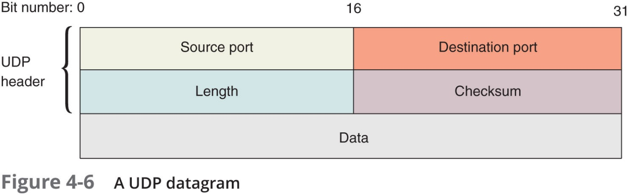
U D P (User Datagram Protocol) (2 of 2)

Slide 12
I P (Internet Protocol) (1 of 4)
I P operates at the Network layer of the O S I model:
Specifies where data should be delivered
Identifies the data’s source and destination I P addresses
I P enables T C P/I P to internetwork
Traverse more than one LAN segment and more than one type of network through a router
I P is an unreliable, connectionless protocol
Means that I P does not guarantee delivery of data and no session is established before data is transmitted
I P depends on T C P to ensure messages are put back together in the right order and to ensure each message reaches the correct application on the receiving host

Slide 13
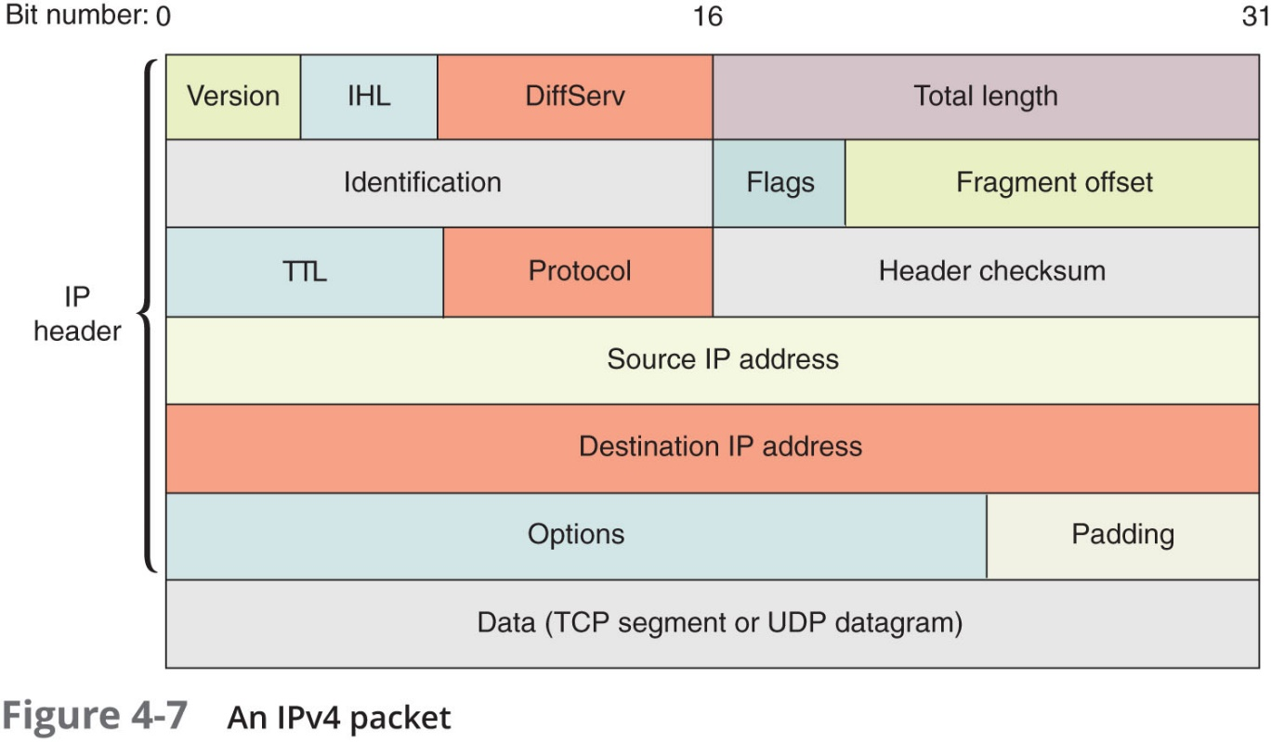
I P (Internet Protocol) (2 of 4)

Slide 14
I P (Internet Protocol) (3 of 4)
I P v 6 packets:
I P v 6 uses a different packet format than I P v 4
Accommodate the much longer I P v 6 addresses
There is no Fragment offset field
I P v 6 hosts adjust their packet sizes to fit the requirements of the network before sending I P v 6 messages

Slide 15
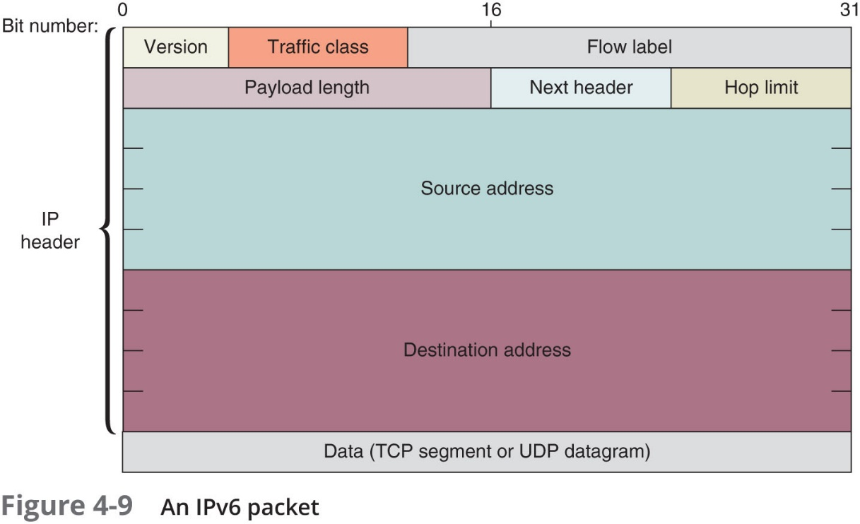
I P (Internet Protocol) (4 of 4)

Slide 16
I C M P (Internet Control Message Protocol) (1 of 3)
I C M P is a Network layer, core protocol that reports on the success or failure of data delivery
I C M P can indicate:
When part of a network is congested
When data fails to reach its destination
When data has been discarded because the allotted T T L has expired
I C M P announces transmission failures to the sender
But does not correct errors it detects
Provides critical information for troubleshooting network problems
I C M P v 6 on I P V 6 networks performs the functions of I C M P and A R P on I P v 4 networks

Slide 17
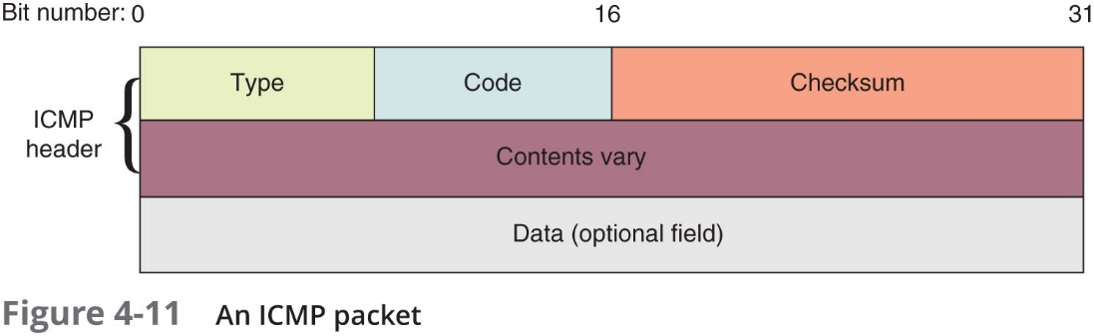
I C M P (Internet Control Message Protocol) (2 of 3)

Slide 18
I C M P (Internet Control Message Protocol) (3 of 3)
Table 4-7 An I C M P packet
Field | Length | Function
Type | 8 bits | Indicates the type of I C M P message, such as Destination Unreachable
Code | 8 bits | Indicates the subtype of the message, such as Destination host unknown
Checksum | 16 bits | Allows the receiving node to determine whether the I C M P packet became corrupted during transmission
Rest of header | 32 bits | Varies depending on message type and subtype
Data | Variable | Usually contains the I P header and first 8 bytes of the data portion of the IP packet that triggered the ICMP message

Slide 19
A R P (Address Resolution Protocol) on I P v 4 Networks (1 of 4)
A R P works in conjunction with I P v 4 to discover the MAC address of a host or node on the local network
And to maintain a database that maps IP addresses to MAC addresses on the local network
A R P is a Layer 2 protocol that uses I P in Layer 3
Operates only within its local network
A R P relies on broadcasting
A R P table—The database of I P-to-MAC address mappings

Slide 20
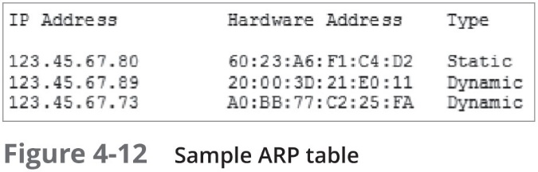
A R P (Address Resolution Protocol) on I P v 4 Networks (2 of 4)

Slide 21
A R P (Address Resolution Protocol) on I P v 4 Networks (3 of 4)
An A R P table can contain two types of entries:
Dynamic—Created when a client makes an A R P request that could not be satisfied by data already in the A R P table
Static—Those someone entered manually using the A R P utility (arp command)
To view a Window’s workstation’s A R P table, enter the command:
arp -a

Slide 22
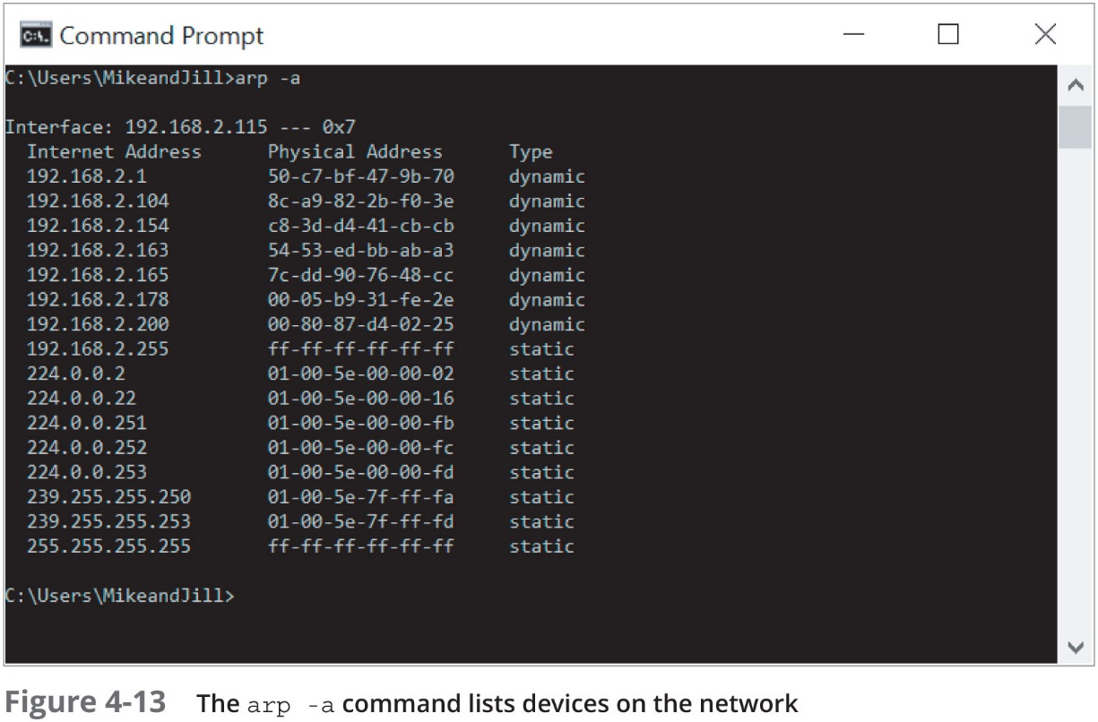
A R P (Address Resolution Protocol) on I P v 4 Networks (4 of 4)

Slide 23
Ethernet (1 of 3)
Ethernet:
Most important Data Link layer standard
Capable of running on a variety of network media
Offers excellent throughput at a reasonable cost
Most popular network technology used on modern LANs
Ethernet II is the current standard
Adds both a header and a trailer to the payload
Creates a frame around the payload

Slide 24
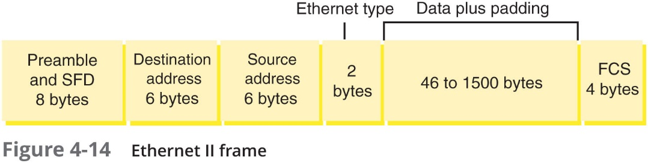
Ethernet (2 of 3)

Slide 25
Ethernet (3 of 3)
The header and F C S make up the 18-byte “frame” around the data
Data portion of an Ethernet frame may contain from 46 to 1500 bytes
M T U (maximum transmission unit)
The largest size that routers in a message’s path will allow at the Network Layer
Exceptions to Ethernet frame size limitations:
Ethernet frames on a V LAN can have an extra 4-byte field between the Source address field and the Type field
Some special-purpose networks use a proprietary version of Ethernet that allows for a jumbo frame
The M T U can be as high as 9198 bytes, depending on the type of Ethernet architecture used

Slide 26
Routers and How They Work (1 of 4)
A router joins two or more networks and passes packets from one network to another
Routers can do the following:
Connect dissimilar networks (LANs and WANs)
Interpret Layer 3 and often Layer 4 addressing
Determine the best path for data to follow from point A to point B
Reroute traffic if the path of first choice is down but another path is available

Slide 27
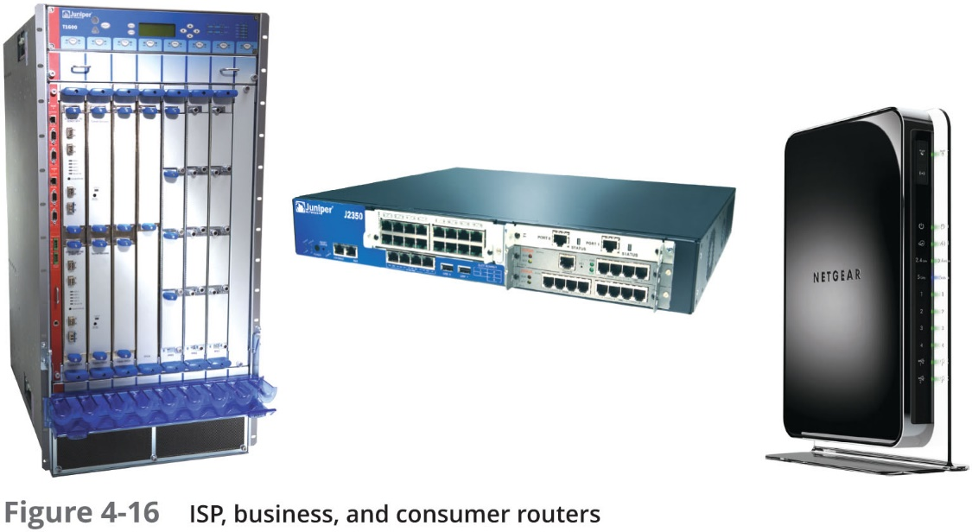
Routers and How They Work (2 of 4)

Slide 28
Routers and How They Work (3 of 4)
Routers may perform any of the following optional functions:
Filter broadcast transmissions
Prevent certain types of traffic from getting to a network
Support simultaneous local and remote connectivity
Provide high network fault tolerance through redundant components such as power supplies
Monitor network traffic and report statistics
Diagnose internal or other connectivity problems and trigger alarms

Slide 29
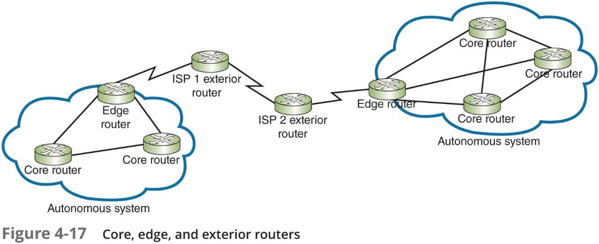
Routers and How They Work (4 of 4)
Router categories:
Core routers, also called interior routers—Direct data between networks within the same autonomous system (A S)
Edge routers, or border routers—Connect an autonomous system with an outside network
Exterior routers—Refers to any router outside the organization’s A S
Direct data between autonomous systems

Slide 30
Multilayer Switches
Layer 3 switch—Capable of interpreting Layer 3 data and works much like a router:
Usually faster and less expensive
Primary difference is the way the hardware is built
Layer 4 switch—Capable of interpreting Layer 4 data:
Also known as content or application switches
Enables switch to perform advanced filtering, keep statistics, and provide security functions
Typically used as part of a network’s backbone

Slide 31
Routing Tables (1 of 2)
Routing table—A database that maintains information about where hosts are located and the most efficient way to reach them
Routers rely on them to identify which router is the next hop to reach a particular destination host
Routing tables contain IP addresses and network masks that identify a network that a host or another router belongs to

Slide 32
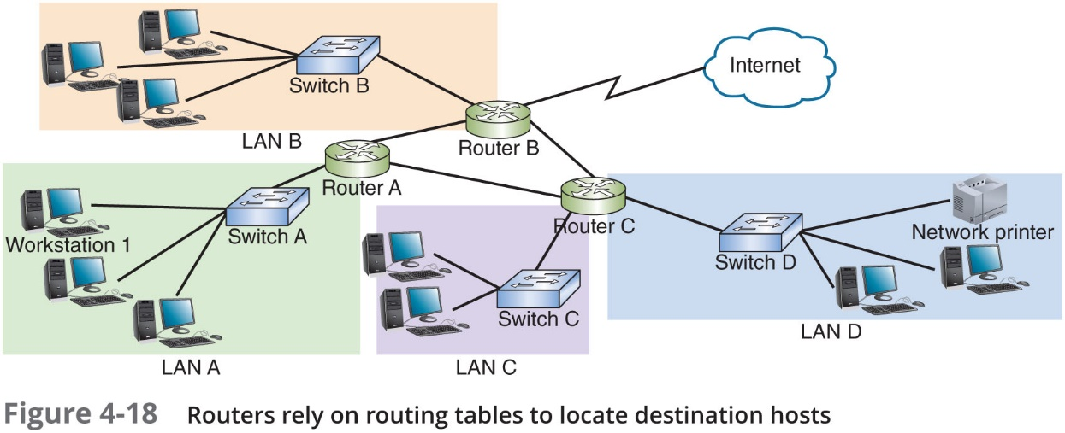
Routing Tables (2 of 2)

Slide 33
Routing Path Types
Static routing—Network administrators configures a routing table to direct messages along specific paths
Example—A static route between a small business and its I S P
Dynamic routing—Automatically calculates the best path between two networks and maintains this information in a routing table
Router can detect problems with failed or congested routes and reroute messages through a different path

Slide 34
The route Command
The route command allows you to view a host’s routing table:
On a Linux or UNIX system, use the command route
On a Windows-based system, use the command route print
On a Cisco I O S, use the command show ip route

Slide 35
Routing Metrics
Routing metrics—Properties of a route used by routers to determine the best path to a destination:
Hop count
Theoretical bandwidth and actual throughput
Delay, or latency, on a potential path
Load, or the traffic or processing burden
M T U (maximum transmission unit) or the largest I P packet size in bytes allowable without fragmentation
Routing cost, or a value assigned to a particular route
Reliability of a potential path
Topology of a network

Slide 36
Routing Protocols to Determine Best Paths (1 of 2)
Routing protocols—Used by routers to communicate with each other to determine the best path
Routers rate the reliability and priority of a routing protocol’s data based on these criteria:
Administrative distance (A D)—A number indicating the protocol’s reliability
Convergence time—Time it takes to recognize a best path in the event of a change or network outage
Overhead—The burden placed on the underlying network to support the protocol

Slide 37
Routing Protocols to Determine Best Paths (2 of 2)
Table 4-10 Summary of common routing protocols
Routing Protocol | Type | Algorithm Used
R I P (Routing Information Protocol) | I G P | Distance-vector
R I Pv2 (Routing Information Protocol, version 2) | I G P | Distance-vector
O S P F (Open Shortest Path First) | I G P | Link-state
I S-I S (Intermediate System to Intermediate System) | I G P | Link-state
E I G R P (Enhanced Interior Gateway Routing Protocol) | I G P | Advanced distance-vector
B G P (Border Gateway Protocol) | E G P | Advanced distance-vector or path vector

Slide 38
Interior and Exterior Gateway Protocols (1 of 6)
I G P (interior gateway protocols)—Used by core routers and edge routers within autonomous systems and are often grouped according to the algorithms they use to calculate best paths:
Distance-vector routing protocols—Calculate path on the basis of the distance to that destination
Link-state routing protocols—Enables routers to communicate beyond neighboring routers in order to independently map the network and determine the best path
E G P (exterior gateway protocols)—Used by edge routers and exterior routers to distribute data outside of autonomous systems
The only E G P currently in use is B G P

Slide 39
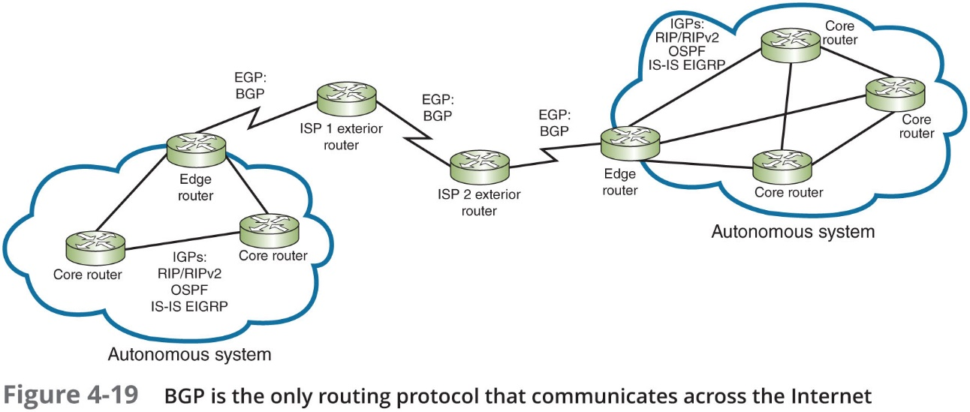
Interior and Exterior Gateway Protocols (2 of 6)

Slide 40
Interior and Exterior Gateway Protocols (3 of 6)
O S P F (Open Shortest Path First)—An I G P and a link-state protocol used on interior or border routers
Introduced as an improvement to R I P
Characteristics:
Supports large networks—Imposes no hop limits (unlike R I P)
Uses a more complex algorithm for determining best paths
Shared data—Maintains a database of other routers’ links
Low overhead, fast convergence—Demands more memory and C P U power for calculations, but keeps network bandwidth to a minimum and provides a very fast convergence time
Stability—Uses algorithms that prevent routing loops
Multi-vendor routers—Supported by all modern routers

Slide 41
Interior and Exterior Gateway Protocols (4 of 6)
I S-I S (Intermediate System to Intermediate System)—An I G P and link-state routing protocol:
Uses a best-path algorithm similar to O S P F
Is designed for use on core routers only (unlike O S P F)
Not handcuffed to I P v 4 (like O S P F) so it’s easy to adapt to I P v 6
Service providers generally prefer I S-I S because it’s more scalable than O S P F

Slide 42
Interior and Exterior Gateway Protocols (5 of 6)
E I G R P (Enhanced Interior Gateway Routing Protocol)—An advanced distance-vector protocol that combines some of the features of a link-state protocol
Often referred to as a hybrid protocol
Fast convergence time and low network overhead
Easier to configure and less C P U-intensive than O S P F
Supports multiple protocols and limits unnecessary network traffic between routers
Originally proprietary to Cisco routers

Slide 43
Interior and Exterior Gateway Protocols (6 of 6)
B G P (Border Gateway Protocol)—The only current E G P and is known as the “protocol of the Internet”
Can span multiple autonomous systems
A path-vector routing protocol that communicates via B G P-specific messages that travel between routers
Determines the best paths based on many different factors
Can be configured to follow policies that might avoid a certain router or instruct a group of routers to prefer a particular route
The most complex of the routing protocols

Slide 44
Troubleshooting Route Issues
T C P/I P comes with a set of utilities that can help track down most T C P/I P related problems
You should be familiar with the tools and their parameters

Slide 45
Troubleshooting Tools (1 of 8)
netstat—Displays T C P/I P statistics and details about T C P/I P components/connections on a host
Information that can be obtained from the netstat command includes:
The port on which a T C P/I P service is running
Which network connections are currently established for a client
How many messages have been handled by a network interface since it was activated
How many data errors have occurred on a particular network interface

Slide 46
Troubleshooting Tools (2 of 8)
Table 4-11 netstat command options
netstat command | Description
netstat | Lists all active T C P/I P connections on the local machine, including the Transport layer protocol used, messages sent, and received, I P address, and state of those connections
netstat -n | Lists current connections, including I P addresses and ports
netstat -f | Lists current connections, including I P addresses, ports, and F Q D N s
netstat -a | Lists all current T C P connections and all listening T C P and U D P ports
netstat -e | Displays statistics about messages sent over a network interface, including errors and discards
netstat -s | Displays statistics about each message transmitted by a host, separated according to protocol type (T C P, U D P, IP, or I C M P)
netstat -r | Displays routing table information
netstat -o | Lists the PID (process identifier) for each process using a connection and information about the connection
netstat -b | Lists the name of each process using a connection and information about that connection

Slide 47
Troubleshooting Tools (3 of 8)
tracert or traceroute
Windows tracert utility uses I C M P echo requests to trace the path from one networked node to another, identifying all intermediate hops between the nodes
Linux, UNIX, and O S X systems use the traceroute utility to send U D P messages to a random port on the destination node (concept is the same as tracert)
Both utilities employ a trial-and-error approach to discover the nodes at each hop from source to destination

Slide 48
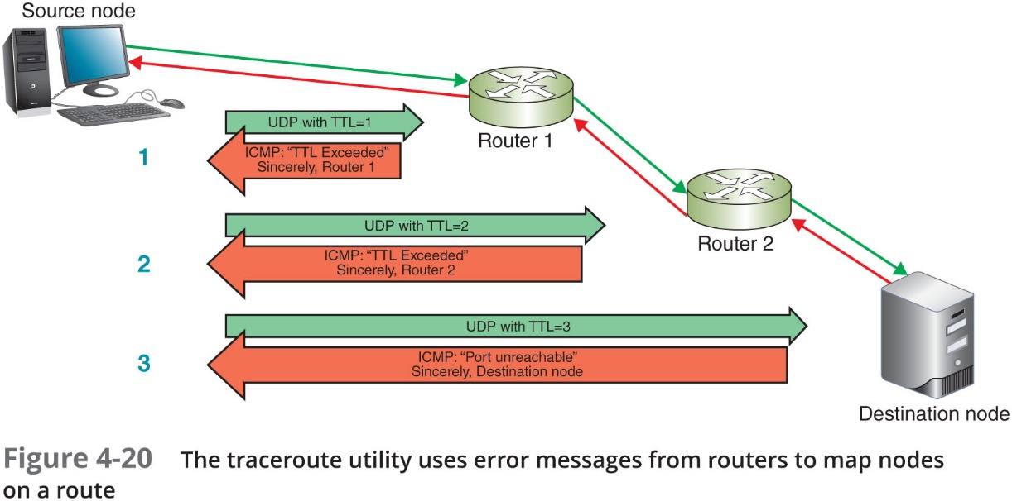
Troubleshooting Tools (4 of 8)

Slide 49
Troubleshooting Tools (5 of 8)
tracert or traceroute (continued)
A trace test might stop before reaching the destination for one of three reasons:
The device the trace is attempting to reach is down
It’s too busy to process lower-priority messages such as U D P or I C M P
It does not accept the U D P or I C M P transmissions being sent because a firewall blocks these types of messages
A trace cannot detect router configuration problems or predict variations of routes over a period of time

Slide 50
Troubleshooting Tools (6 of 8)
Pathping—A Windows utility that combines elements of both ping and tracert to provide deeper information about network issues along a route
Sends multiple pings to each hop along a route, then compiles information into a single report
Table 4-13 pathping command options
Pathping command | Description
pathping -n google.com | Instructs the command to not resolve IP addresses to host names
pathping -h 12 google.com | Specifies the maximum number of hops these messages should take when attempting to reach a host
pathping -p 2000 google.com | Identifies the wait time between pings
pathping -q 4 google.com | Limits the number of queries per hop; must be followed by a variable to indicate the number of queries allowed

Slide 51
Troubleshooting Tools (7 of 8)
tcpdump—A free, command-line packet sniffer that runs on Linux and other Unix O Ss
Captures traffic that crosses a computer’s network interface
Output can be saved to a file that you can filter or play back
You must either use the sudo command or log in as root to access tcpdump

Slide 52
Troubleshooting Tools (8 of 8)
Table 4-14 tcpdump command options
Tcpdump command | Description
tcpdump not port 22 or tcpdump no port 23 | Filters out S S H or Telnet packets, which is helpful when running tcpdump on a remotely access network device
tcpdump -n | Instructs the command to not resolve I P addresses to host names
tcpdump –c 50 | Limits the number of captured packets to 50
tcpdump -i any | Listens to all network interfaces on a device
tcpdump -D | Lists all interfaces available for capture
tcpdump port http | Filters out all traffic except H T T P
tcpdump -w capture.cap | Saves the file output to a file named capture.cap
tcpdump -r capture.cap | Reads the file capture.cap and outputs the data in the terminal window

Slide 53
Solving Common Routing Problems (1 of 4)
Table 4-15 Command-line utilities
Command | Common uses
arp | Provides a way of obtaining information from and manipulating a device’s A R P table
dig | Queries D N S servers with more advanced options than nslookup
ipconfig or ifconfig | Provides information about T C P/I P network connections and the ability to manage some of those settings
netstat | Displays T C P/I P statistics and details about T C P/I P components and connections on a host
nmap | Detects, identifies, and monitors devices on a network
nslookup | Queries D N S servers and provides the ability to manage the settings for accessing those servers
pathping (mtr on Linux/UNIX/mac O S) | Sends multiple pings to each hop along a route, then compiles the information into a single report
ping | Verifies connectivity between two nodes on a network
route | Displays a host’s routing table
tcpdump | Captures traffic that crosses a computer’s network interface
traceroute or tracert | Traces the path from one networked node to another, identifying all intermediate routers between the two nodes

Slide 54
Solving Common Routing Problems (2 of 4)
Duplicate MAC Addresses:
Two devices on the same network with the same MAC address is a problem
MAC addresses can be impersonated
A security risk called spoofing
Happens most often when managing multiple virtual devices on a large network
Most switches will detect the problem and produce helpful error messages
Then it’s a matter of tracking down which virtual devices have the same MAC address and update each device’s configuration

Slide 55
Solving Common Routing Problems (3 of 4)
Hardware failure—When a router, switch, N I C, or other hardware goes down
Use tracert or traceroute to track down malfunctioning routers and other devices on larger networks
Get more accurate trace feedback on a questionable router by targeting a node on the other side of that router, rather than aiming for that router itself
Use ping to test for network connectivity

Slide 56
Solving Common Routing Problems (4 of 4)
Discovering neighbor devices—A process used by routers to learn about all of the devices on their networks:
On I P v 4 networks, neighbor discovery is managed by A R P with help from I C M P
I P v 6 devices use Neighbor Discovery Protocol (N D P) to automatically detect neighboring devices and automatically adjust when neighboring nodes fail or are removed
Eliminates the need for A R P and I C M P functions in I P v 6 networks

Slide 57
Chapter Summary (1 of 3)
T C P/I P is a suite of protocols that includes T C P, I P (I P v 4 and I P v 6), U D P, A R P, and many others
T C P operates at the Transport layer and provides reliable data delivery
U D P is an unreliable, connectionless protocol that provides no delivery guarantees
I P operates at the Network layer of the O S I model and specifies where data should be delivered
I C M P is a Network layer core protocol that reports on the success or failure of data delivery
A R P works in conjunction with I P v 4 to obtain the MAC address of a host

Slide 58
Chapter Summary (2 of 3)
A router joins two or more networks and passes packets from one network to another
A Layer 3 switch is a switch that is capable of interpreting Layer 3 data and works much like a router
A router relies on its routing table to identify which network a host belongs to and which of the router’s interfaces points toward the best next hop to reach the network
Routing paths are determined by:
Static routing, which are routes configured by a network administrator
Dynamic routing, which are routes automatically calculated by the router
The route command allows you to view a host’s routing table

Slide 59
Chapter Summary (3 of 3)
Routers use routing metrics to determine the best route for messages to take across networks
To communicated with each other, routers use routing protocols that are similar to scouting parties, exploring unknown territories, and collecting data about current network status
Interior gateway protocols are used by core routers and edge routers within an autonomous system
Exterior gateway protocols communicate between autonomous systems
Helpful T C P/I P utilities include ping, ipconfig, ifconfig, nslookup, dig, a r p, route, netstat, tracert, traceroute, pathping, and tcpdump

